Slide 1
Multi-Layer Enterprise Network Implementation
This presentation outlines the detailed configuration and implementation of a robust, secure, and scalable multi-layer enterprise network, incorporating advanced routing, switching, and security protocols.
Under Supervision: Dr. Essam Abdellatef
Presented by:
Basmala ElKady (Leader) 23101372
Sondous Adel 23101396
Rawan Fares 23101891
Rodina Bakr 23101390
Ethar Ahmed 23101369
Menna Allah Osama 23102157
Arwa Mohey Hamdy 23101371

Slide 2

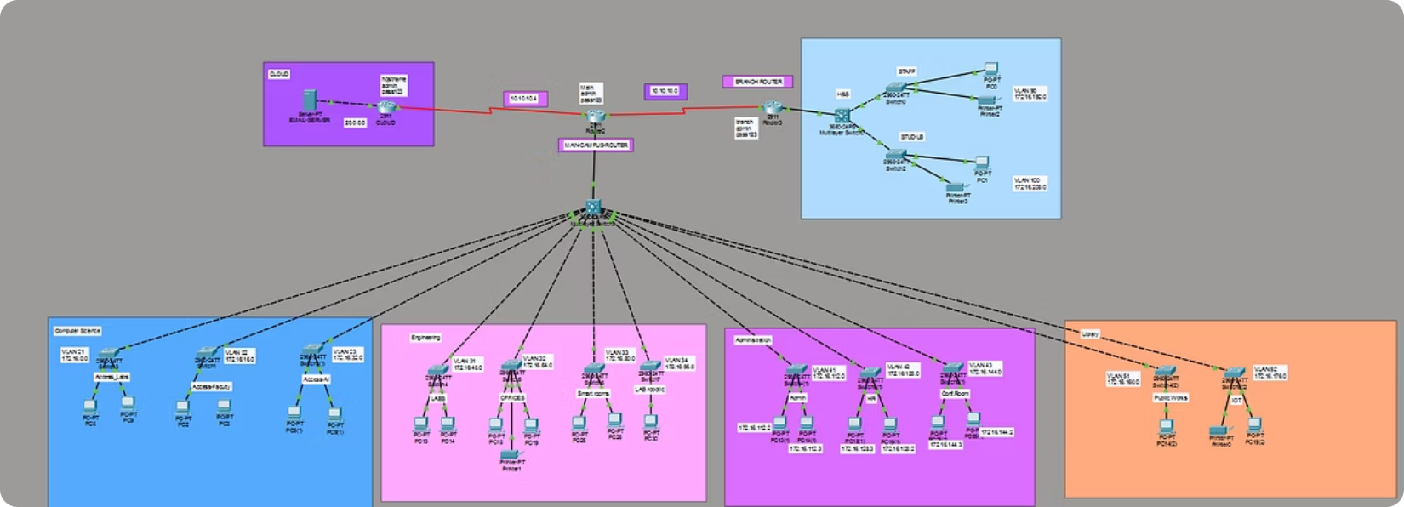
Network Topology Overview
This diagram illustrates the comprehensive network architecture, featuring a hierarchical design with core, distribution, and access layers. It integrates routers, multi-layer switches, and end-devices to ensure efficient data flow and robust connectivity.
Key components include multiple VLANs for segmenting traffic, EIGRP for dynamic routing, and various security mechanisms to protect network integrity.

Slide 3
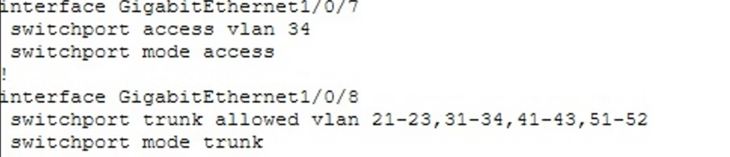
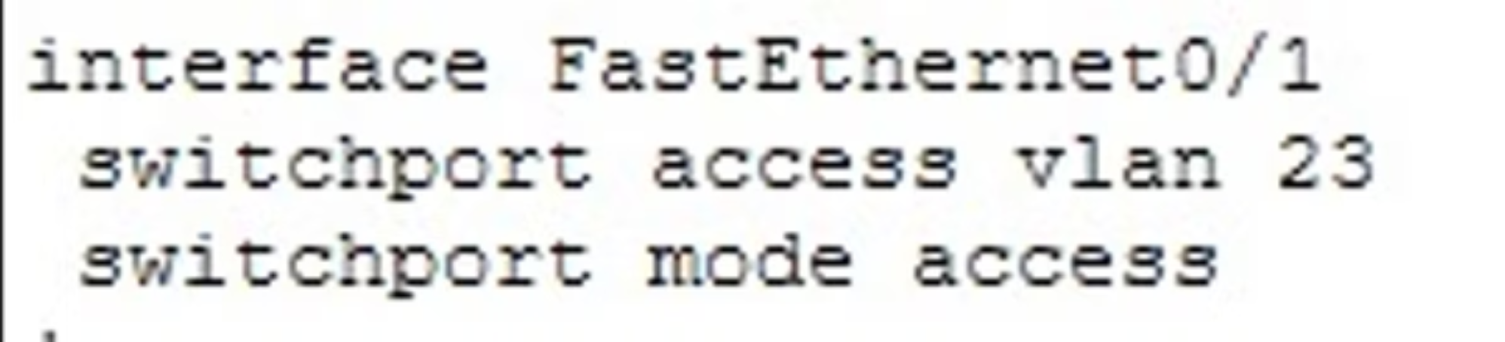
VLAN Configuration and Trunking
VLANs segment the network into logical broadcast domains, enhancing security and performance. Trunk ports allow multiple VLANs to traverse a single physical link, critical for inter-VLAN communication across switches.
Interface GigabitEthernet 0/1/7 Configuration
The GigabitEthernet 0/1 interface is configured as a trunk port, enabling it to carry traffic for VLANs. This setup ensures proper segregation and management of network traffic.
VLAN 21 - 22 - 23: Computer Science
VLAN 31-32-33-34: Engineering
VLAN 41-42-43: Administration
VLAN 51-52: Library

Slide 4
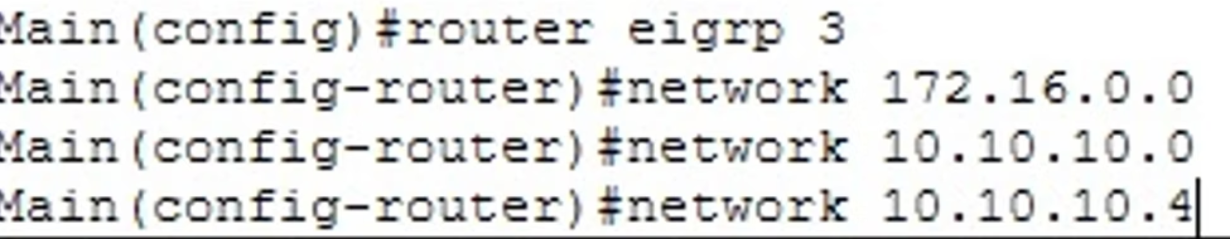
EIGRP Routing Implementation
Enhanced Interior Gateway Routing Protocol (EIGRP) provides efficient and fast convergence for routing within the autonomous system. It dynamically discovers routes and maintains routing tables, ensuring optimal path selection.
EIGRP Configuration Details
Routing Process
Route Summarization
Interface Settings
EIGRP is configured with an Autonomous System (AS) number, defining the scope of the routing domain. This ensures that only routers within the same AS can exchange EIGRP routing information.
Summarization reduces the size of routing tables and optimizes routing efficiency, especially in large networks. It consolidates multiple routes into a single summary address.
Specific interfaces are enabled for EIGRP, allowing them to participate in the routing process and exchange routing updates with neighbors. Passive interfaces can also be configured to prevent unnecessary routing updates on certain segments.

Slide 5
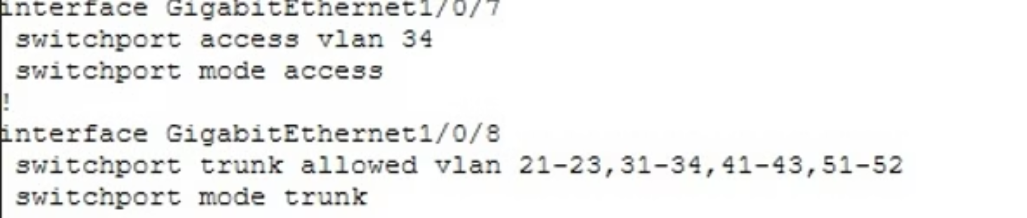
Multi-Layer Switches and Router Connectivity
Multi-layer switches combine Layer 2 switching with Layer 3 routing capabilities, enabling efficient inter-VLAN routing without needing an external router. This optimizes network performance and simplifies network design.
Connecting to a Router
When a multi-layer switch connects to a dedicated router, the router typically handles routing between different subnets or provides external network connectivity (e.g., to the internet). This configuration allows for advanced routing features and perimeter security.
Inter-VLAN Routing
Router on a Stick (RoaS)
Multi-layer switches can perform routing between VLANs, eliminating the need to send traffic to a separate router for internal subnet communication. This is achieved through Switched Virtual Interfaces (SVIs).
For scenarios where a multi-layer switch isn't used for inter-VLAN routing, a single physical interface on a router can be configured with multiple sub-interfaces, each assigned to a different VLAN.

Slide 6
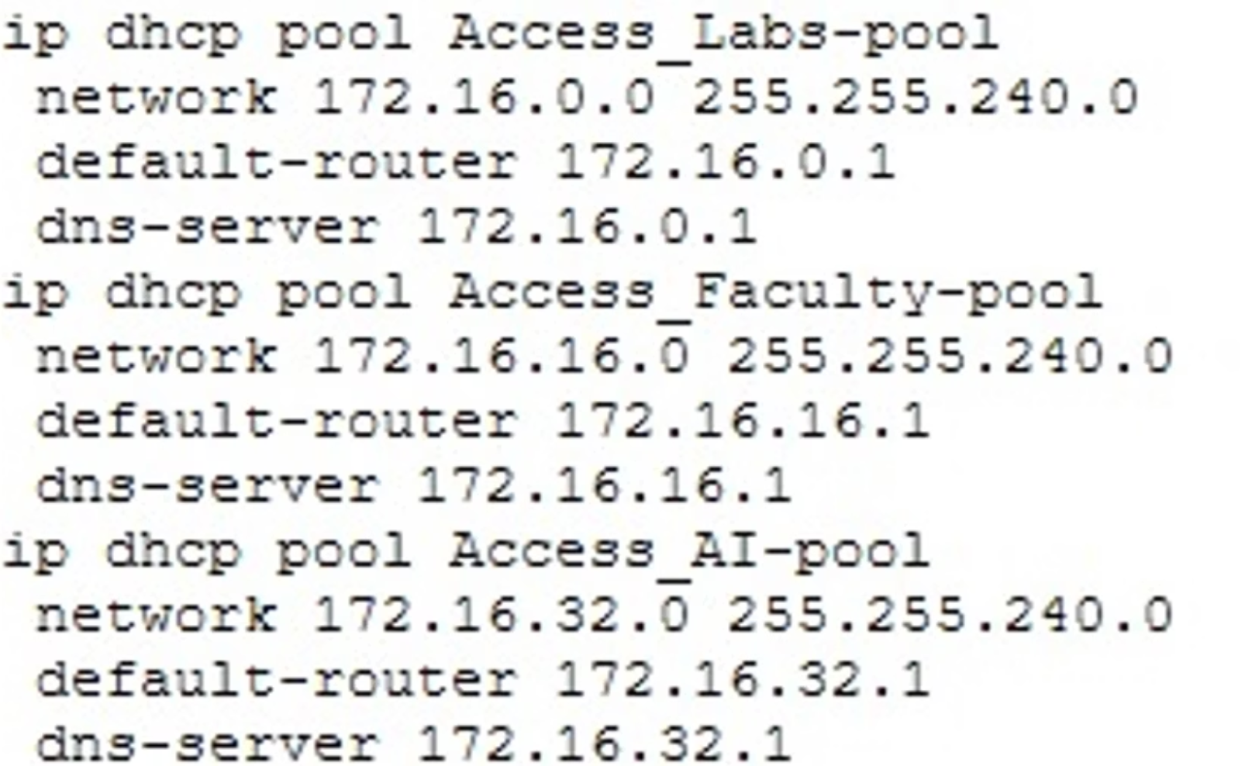
DHCP Configuration for Main Router
Dynamic Host Configuration Protocol (DHCP) automates the assignment of IP addresses and other network configuration parameters to devices on the network, simplifying network management and reducing administrative overhead.
Key DHCP Elements
1
Exclusion Addresses
Specific IP addresses within a DHCP pool can be excluded from automatic assignment to ensure they remain available for static assignments (e.g., servers, network devices).
2
Pool Configuration
DHCP pools are defined for each subnet, specifying the range of IP addresses available for clients, the default gateway, DNS servers, and lease durations.
3
Additional Network Services
DHCP can also provide other network parameters, such as TFTP server addresses or WINS server addresses, depending on network requirements.

Slide 7
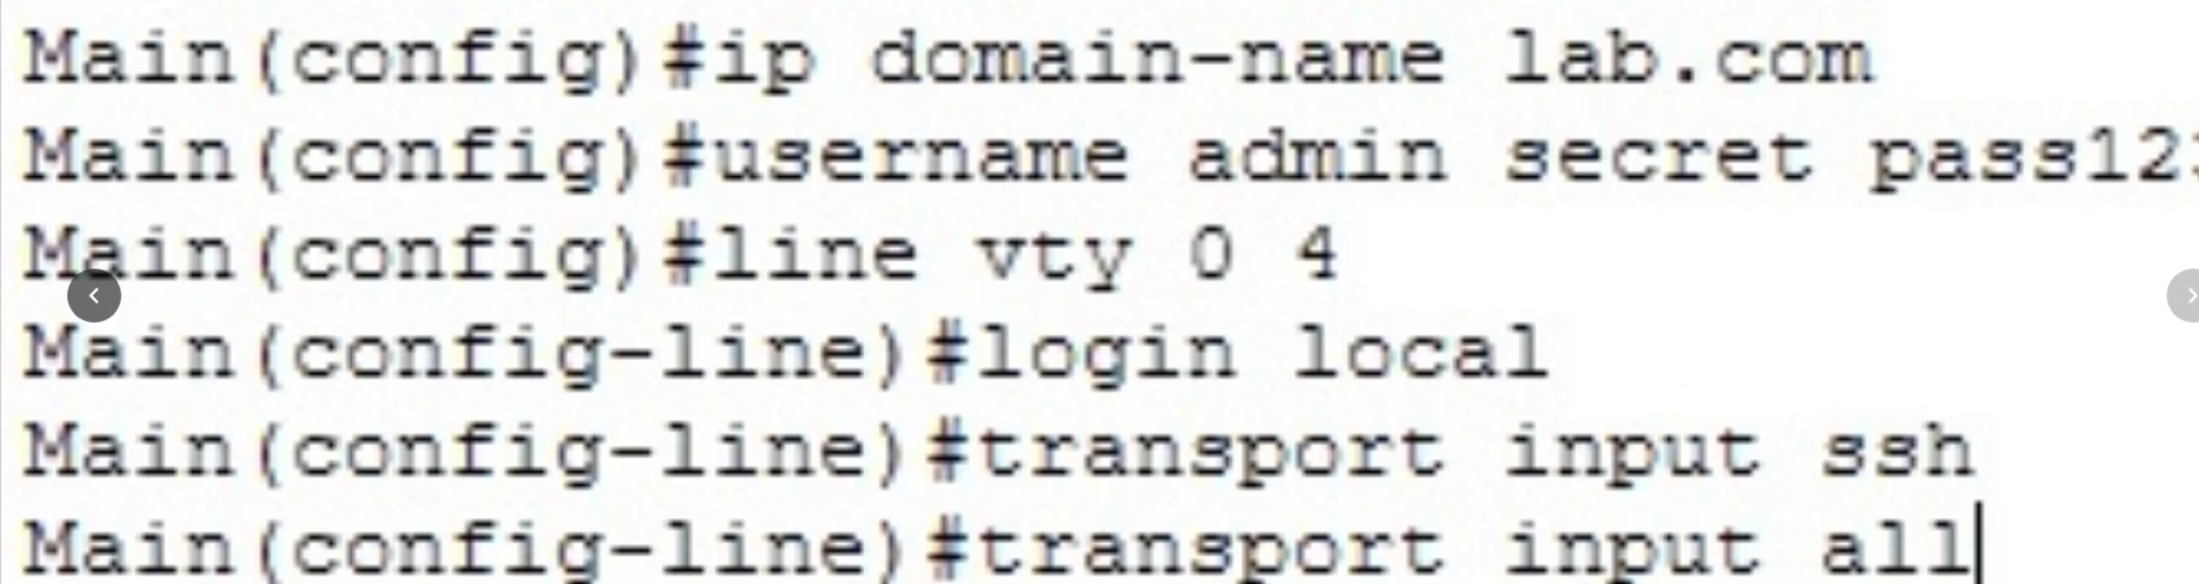
SSH and ACL Configurations
Secure Shell (SSH) provides secure remote access to network devices, protecting against eavesdropping and unauthorized access. Access Control Lists (ACLs) filter network traffic based on defined rules, enhancing network security by controlling what traffic is permitted or denied.
ACL Types
Standard ACLs
Extended ACLs
Filter traffic based on source IP addresses only. They are generally placed closer to the destination.
Filter traffic based on source IP, destination IP, protocol (TCP, UDP, ICMP), and port numbers. They offer more granular control and are typically placed closer to the source.

Slide 8
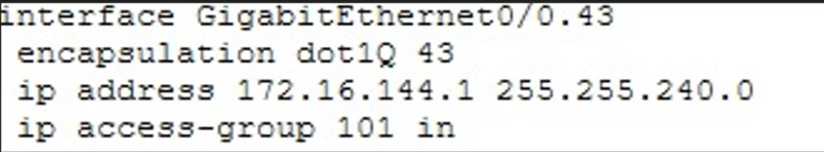
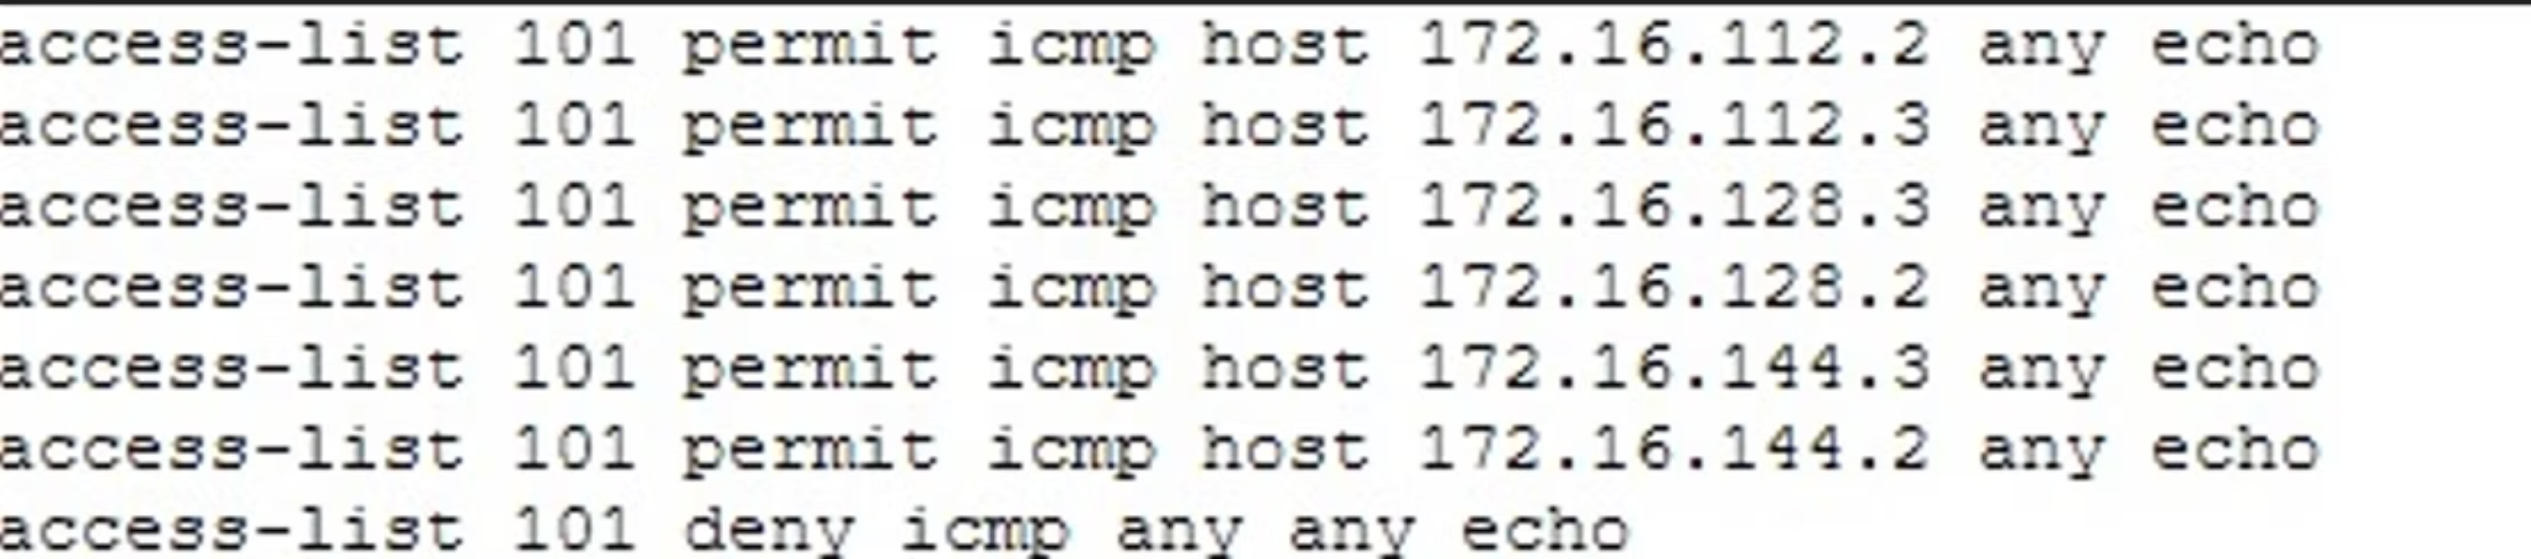
Access List Grouping and IP Routes
Grouping ACLs and understanding IP routes are fundamental for effective network management and security. ACL grouping allows for more organized and scalable security policies, while the routing table (show ip route) provides insights into how traffic is forwarded across the network.
Group-in-of Access-List
This typically refers to applying an ACL to a group of interfaces or for specific purposes within a routing protocol. This enhances network security and control by applying a consistent policy.

Slide 9
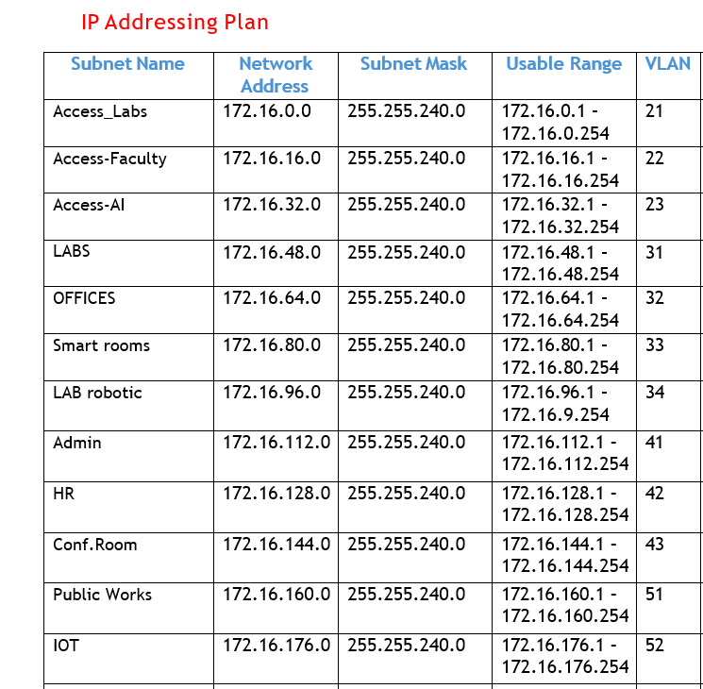
IP Addressing for All Interfaces
Proper IP address allocation is critical for network functionality and organization. Each active interface on routers and multi-layer switches must be assigned a unique IP address within its respective subnet to enable communication.
Interface Configuration Best Practices
Consistent Subnetting
Documentation
Loopback Interfaces
Use a clear and consistent subnetting scheme across the entire network to minimize confusion and simplify routing.
Thoroughly document all IP addresses, subnet masks, and associated interfaces to facilitate troubleshooting and future expansion.
Utilize loopback interfaces for router identification and stability, especially in routing protocols like EIGRP, as they are always up.
Show IP Route Command
The show ip route command displays the router's IP routing table, detailing all known networks, how they were learned (e.g., directly connected, static, EIGRP), and the associated metrics. This is crucial for troubleshooting and verifying connectivity.

Slide 10




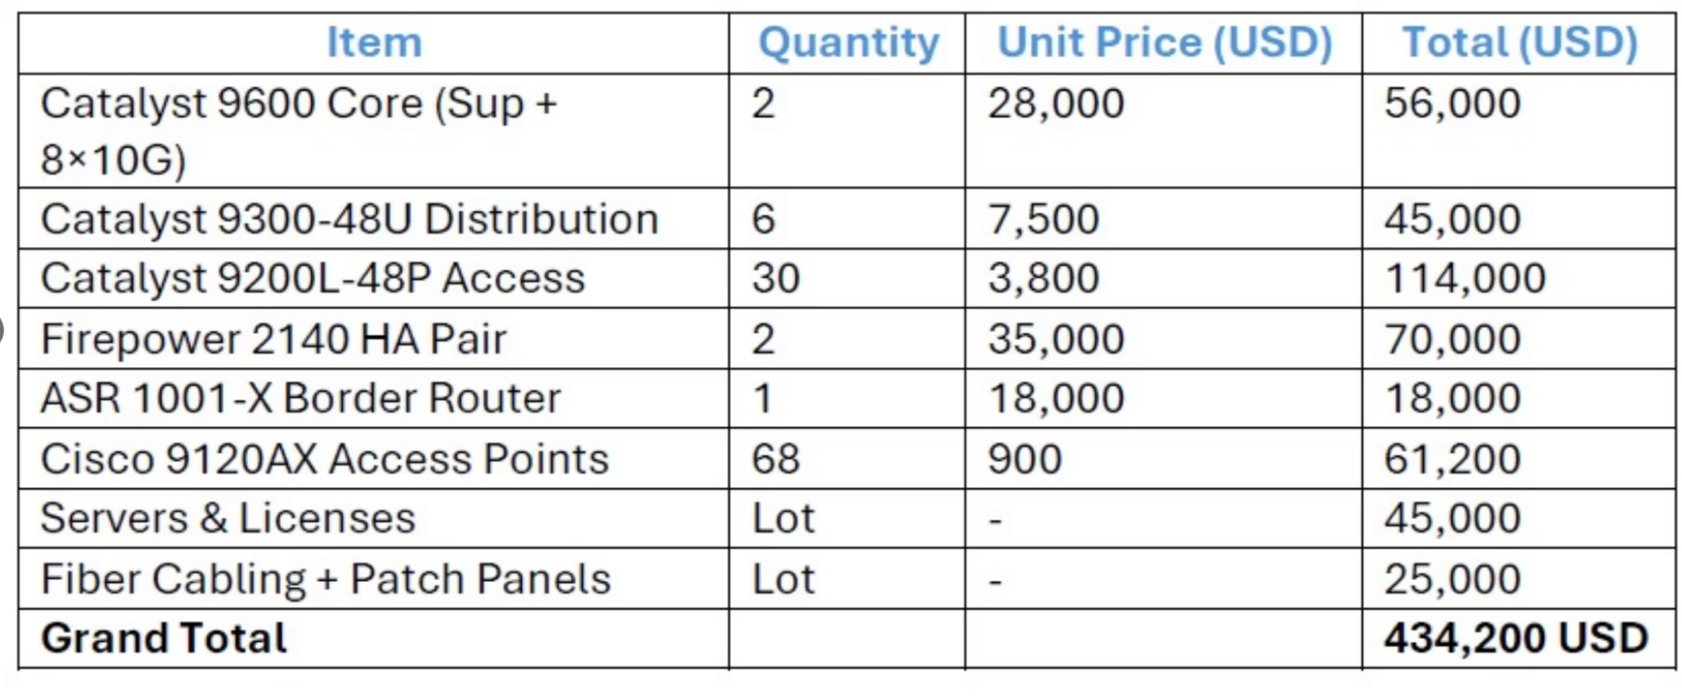
Network Configuration Costs and Benefits
Implementing a robust enterprise network involves various costs, including hardware, software, and labor. However, these investments yield significant benefits in terms of efficiency, security, and scalability. The EIGRP routing protocol is chosen for its efficiency and rapid convergence.
Cost-Benefit Analysis
Reduced Downtime
Robust configurations and redundant systems minimize network outages, leading to higher productivity.
Enhanced Security
ACLs and SSH protect against unauthorized access and cyber threats, safeguarding sensitive data.
Improved Performance
Optimized routing and VLAN segmentation ensure faster data transmission and reduced latency.
Scalability
A well-designed network can easily expand to accommodate future growth and new technologies.

